Slide 1
Why Python?

Slide 2
What is Python?
It features general purpose which is clean and concise syntax, making it easy to learn and use for a wide range of tasks, from
  Web development
  Data analysis
  Artificial intelligence (ml, dl)
  Scientific Computation
  Game Development
Python is a high-level, interpreted programming language known for its
  Simplicity,
  Versatility,
  Readability.
  Community and support.
Python emphasizes code readability and encourages a modular and object-oriented programming approach, fostering rapid development and collaboration.

Slide 3
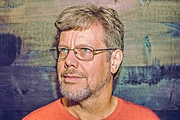
Brief History of Python
Python was created by Mr. Guido van Rossum in the late 1980s, currently there are three version of python
    1st release in 1991.
    2nd Python 2.0 in 2000
    3rd release in 2008 Python 3.0 in,
    It underwent major revisions with aiming for simplicity, readability, and efficiency, evolving into one of the most popular programming languages globally with a rich ecosystem and supportive community.

